Slide 1

MINI PROJECT FINAL REVIEW
By:-
AMIT VIKRAM(1CR19CS018)
ANWESH ONKAR MISHRA(1CR19CS021)
ABHISHEK KUMAR(1CR19CS007)

Slide 2
Create an Online Classroom using REST APIs
MARK ATTENDANCE
SUBMIT ASSIGNMENTS
Students REGISTRATION

Slide 3
TOOLS USED:-
VS code
MongoDB Compass
POSTMAN

Slide 4
LANGUAGES USED:-
MongoDB
EXPRESS JS
REACT JS
NODE JS

Slide 5
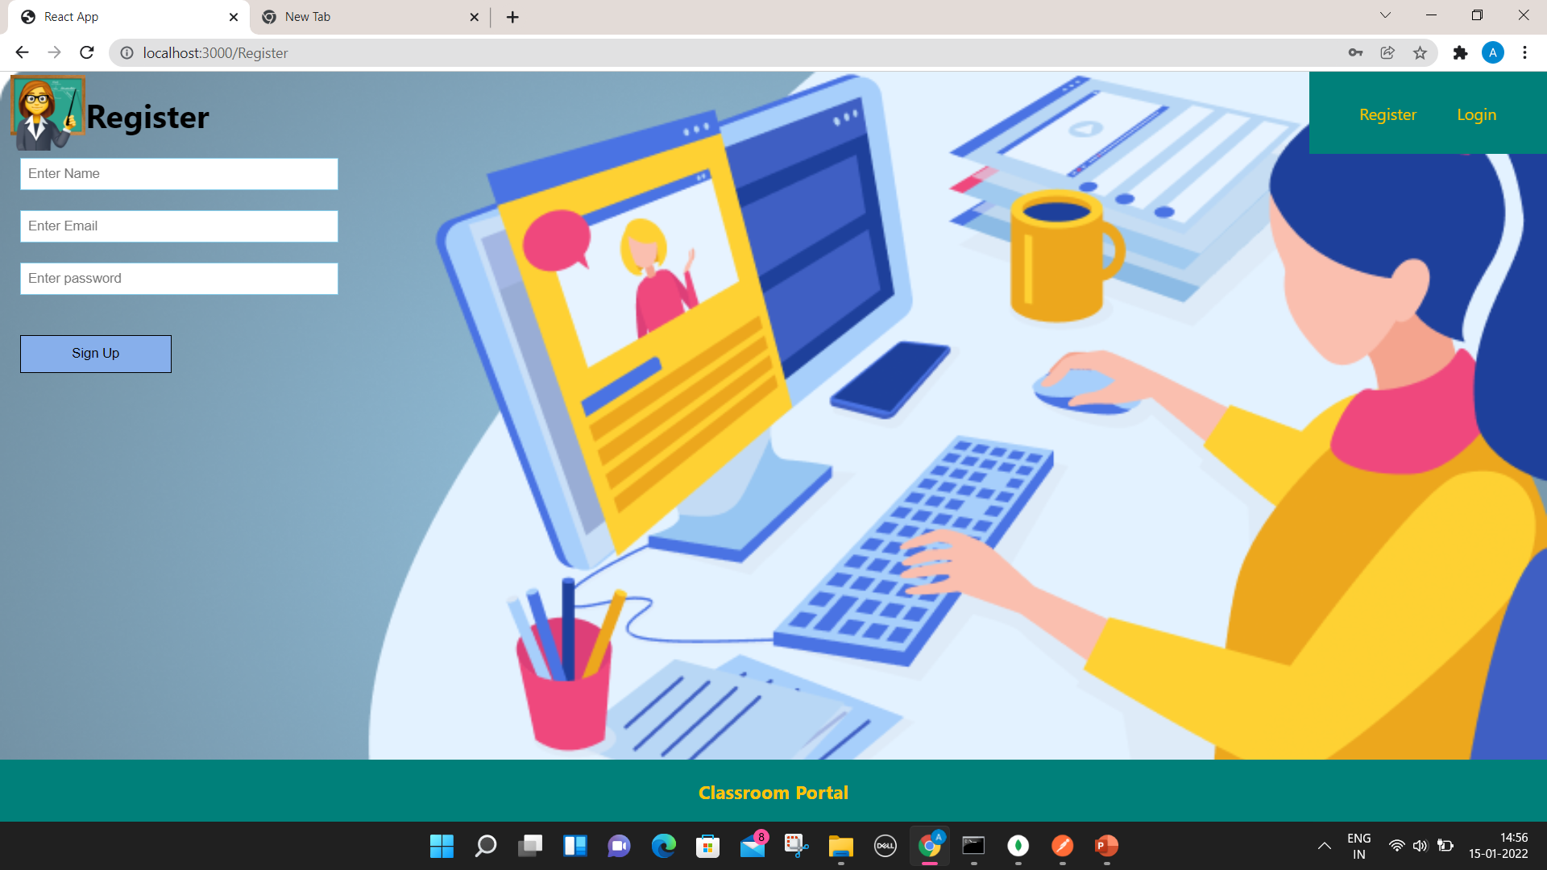
REGISTRATION PORTAL

Slide 6
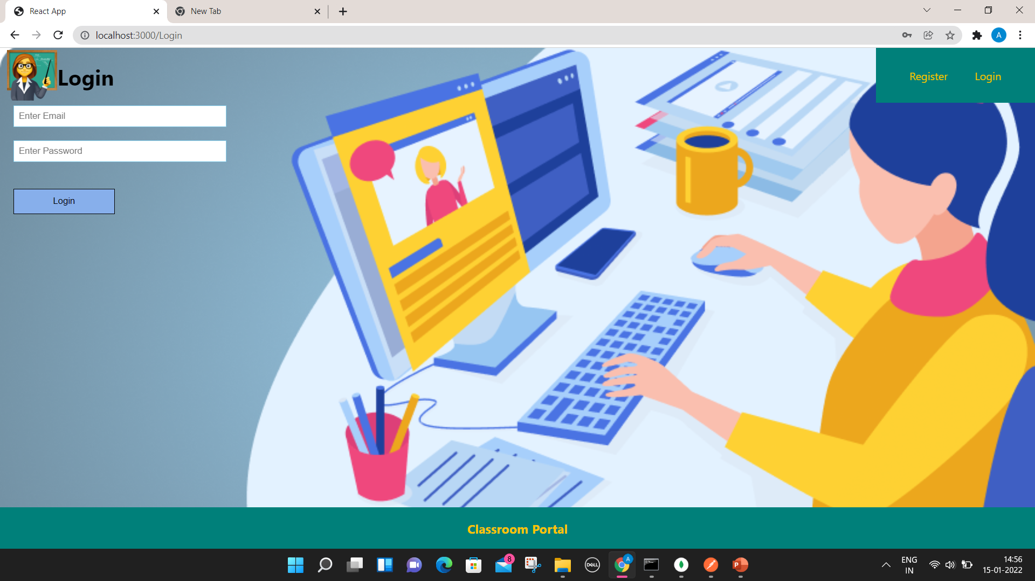
LOGIN PORTAL

Slide 7
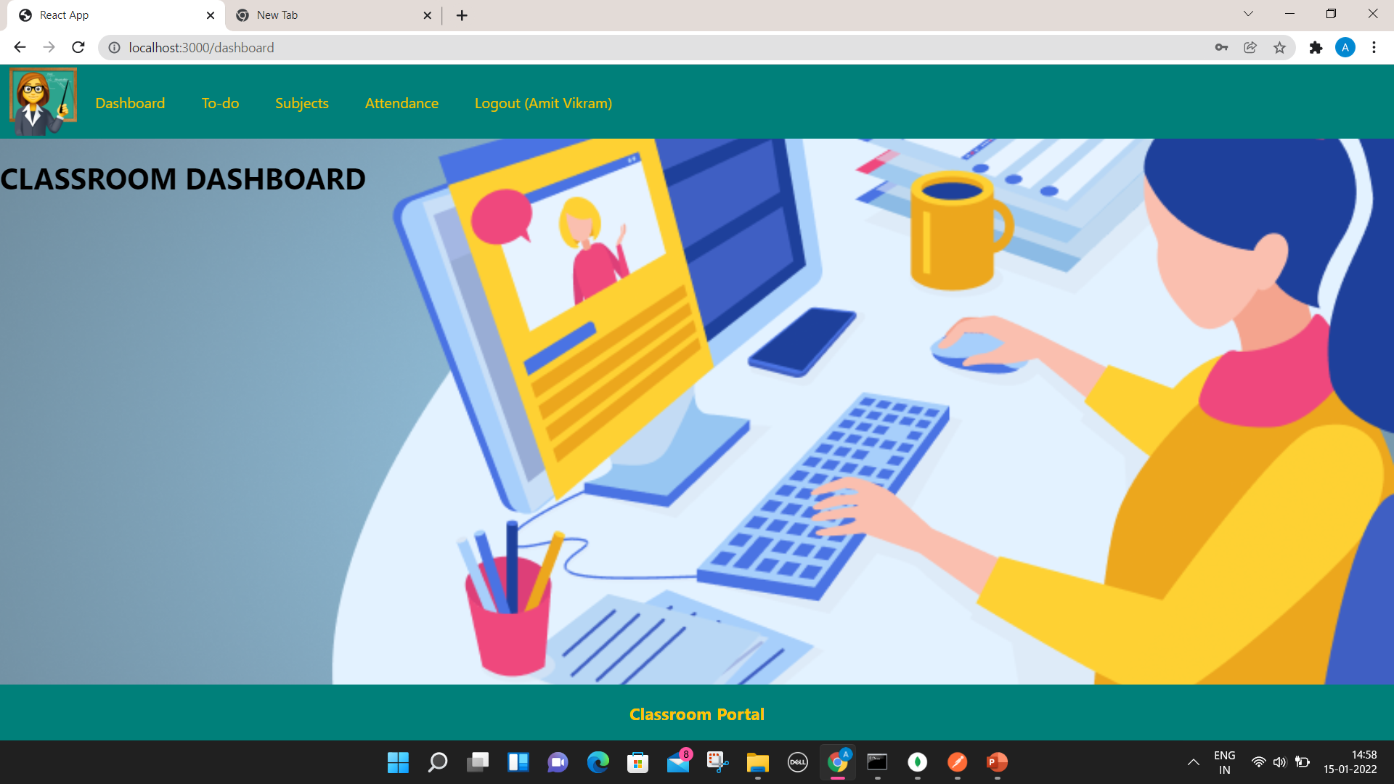
CLASSROOM DASHBOARD

Slide 8
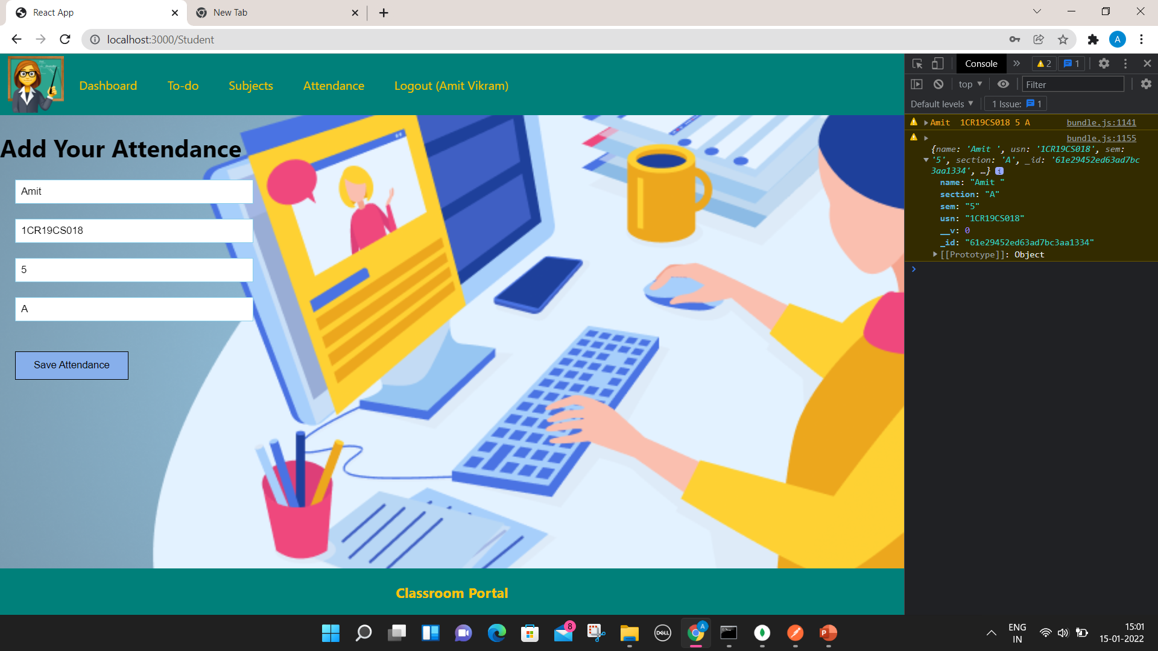
ATTENDANCE PORTAL

Slide 9

SUBJECTS

Slide 10

ASSIGNMENTS PORTAL

Slide 11
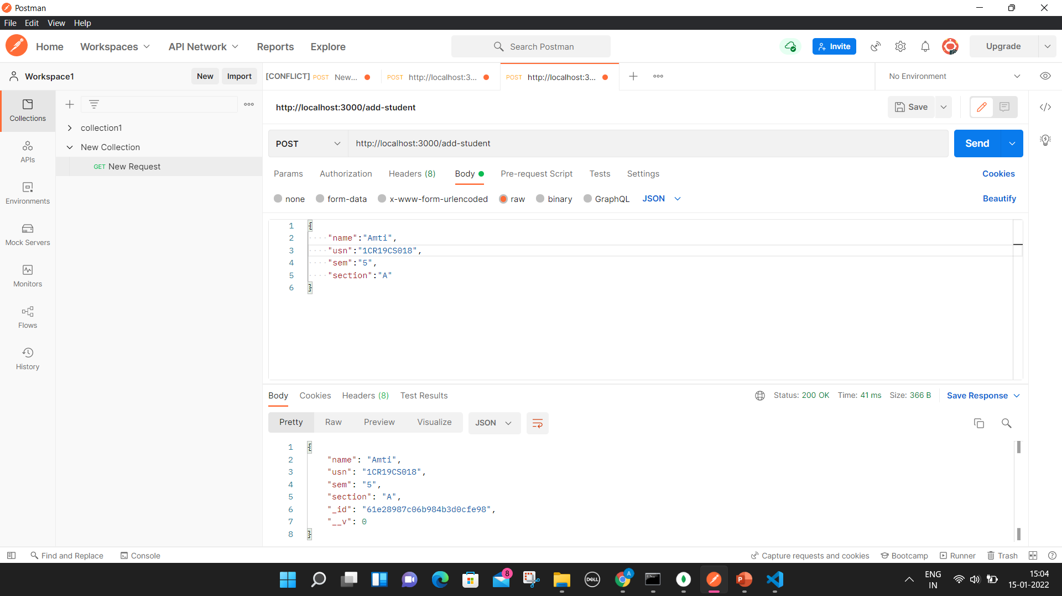
POSTMAN CONFIGURATION

Slide 12
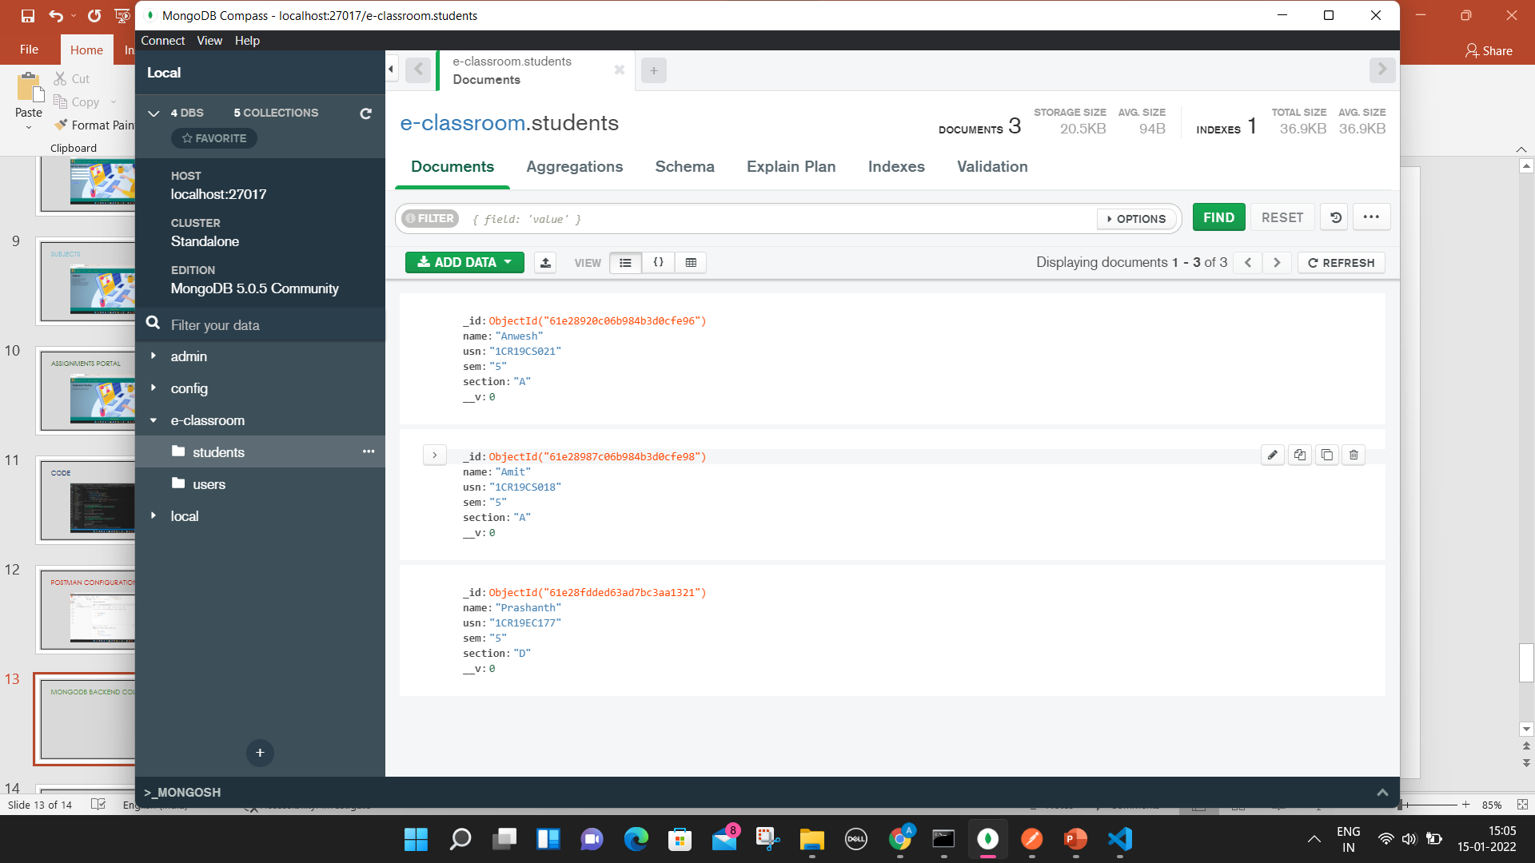
MongoDB Backend: Students

Slide 13
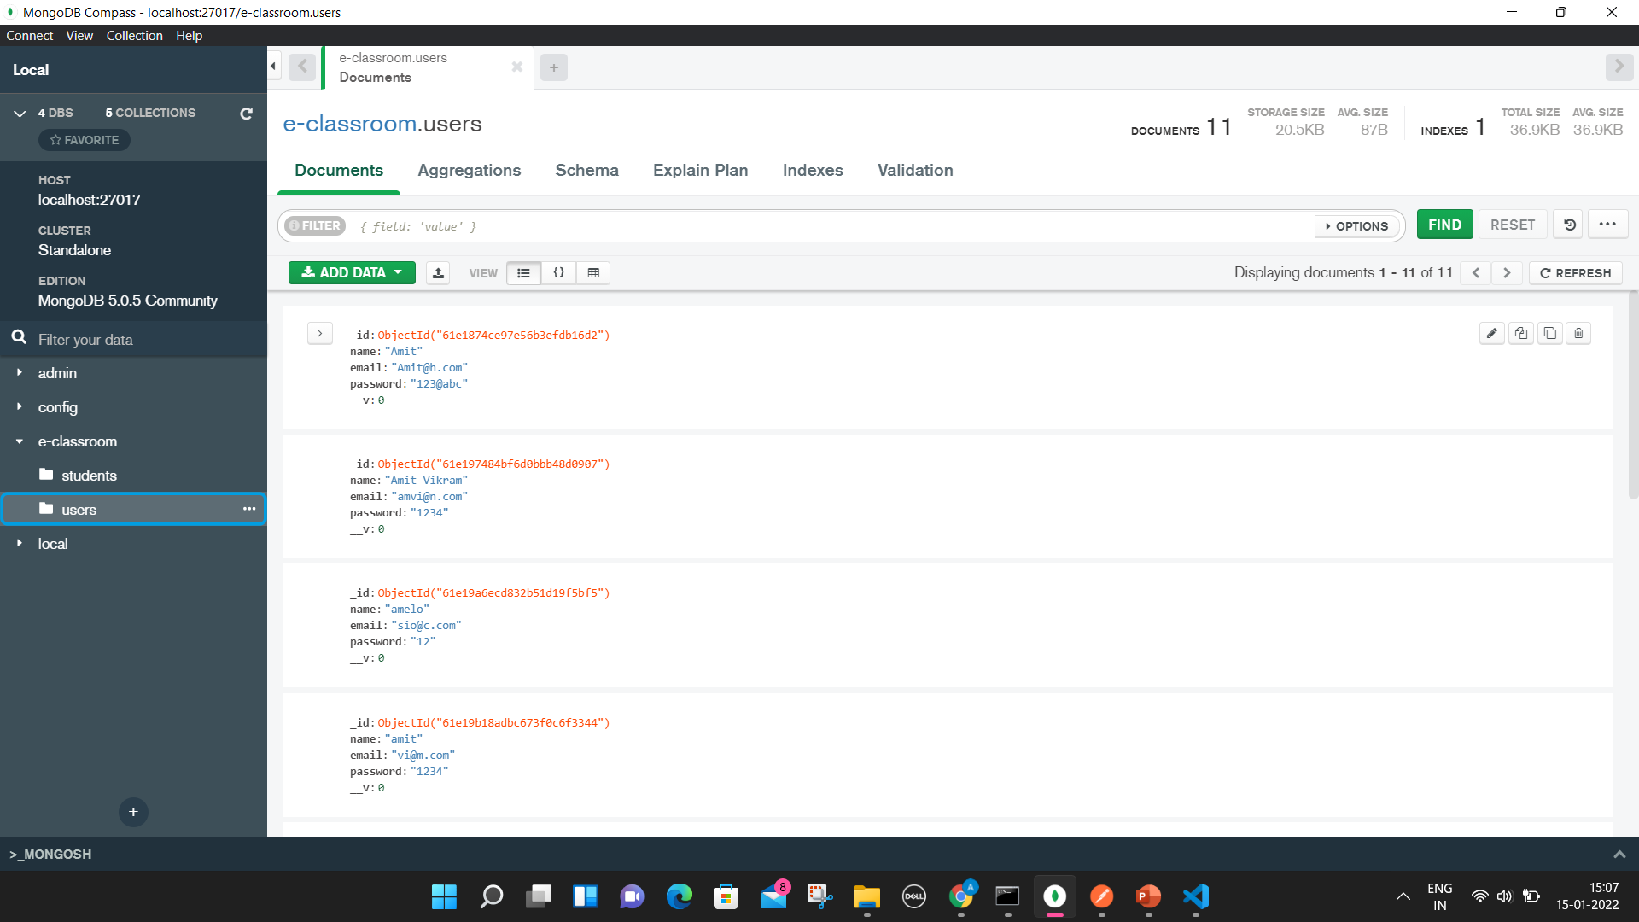
MongoDB Backend: Users

Slide 14
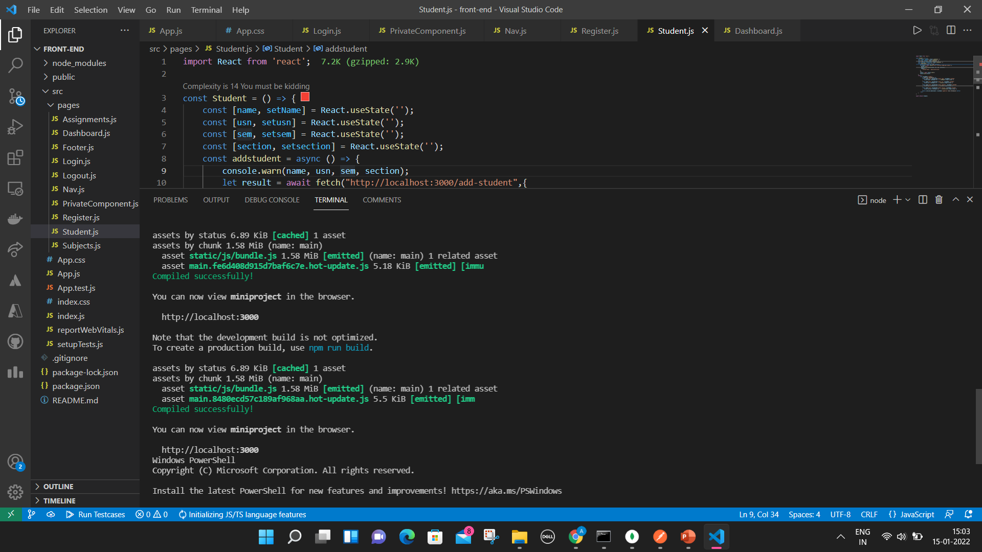
FRONT END CODE

Slide 15
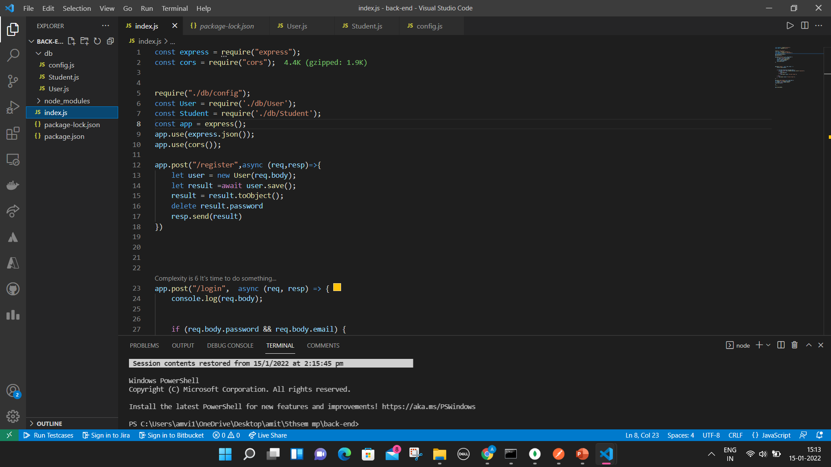
BACK END CODE

Slide 16
FRONT END CODE GITHUB LINK
https://github.com/amvi234/e-classroom_frontend

Slide 17
BACK END CODE GITHUB LINK
https://github.com/amvi234/e-classroom-backend

Slide 18
THANK YOU

